Slide 1
Module 5 .Domestic Wiring . Equipment safety measures . Personal safety measures .Electricity Bill

Slide 2
DOMESTIC WIRING:
Requirements of a Good Wiring System
1. Safety:
Proper Insulation: All wires should be well-insulated to prevent accidental contact and electrical shocks. ( use ISI mark cables)
Grounding: Effective grounding helps prevent electrical fires and protects from electrical shocks.
Overload Protection: Use of circuit breakers, fuses, and RCDs to protect against overloads and short circuits.
2. Durability:
Quality Materials: Use high-quality wires and components that can withstand wear and tear.
Corrosion Resistance: Materials should be resistant to corrosion, especially in environments with high humidity.
3. Adequate Capacity:
Amp rating: Wires should be able to handle the expected electrical load without overheating.
Future-proofing: Consider potential future electrical needs and ensure the wiring can accommodate additional loads.

Slide 3
4. Accessibility:
Ease of Maintenance: Wires should be easily accessible for inspection, repairs, and upgrades.
Conduit System: Use conduits to protect wires and simplify future modifications.
5. Aesthetics:
Neat Installation: Proper routing and organization of wires to maintain a clean and professional appearance.
Concealment: Whenever possible, conceal wiring within walls, floors, or ceilings for a tidy look.
6. Compliance:
Standards and Codes: Adhere to local electrical codes and standards to ensure safety and legality.
7. Labeling:
Clear Identification: Label all wires and components for easy identification and troubleshooting.

Slide 4
Types of Domestic Wiring
Casing and Capping
Conduit Wiring
Surface Conduit Wiring
Concealed Conduit Wiring

Slide 5
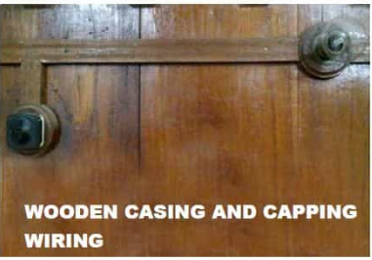
Casing and Capping

Slide 6
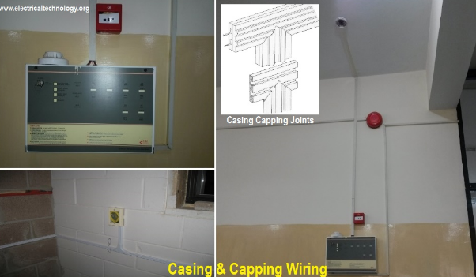

Slide 7
The cables were carried through the wooden casing enclosures. The casing is made up of a strip of wood with parallel grooves cut length wise so as to accommodate VIR or PVC cables.
The grooves were made to separate opposite polarity. the capping (also made of wood) used to cover the wires and cables installed and fitted in the casing.

Slide 8
Advantages of Casing Capping Wiring:
It is cheap wiring system as compared to sheathed and conduit wiring systems.
It is strong and long-lasting wiring system.
Phase and Neutral wire is installed in separate slots, therefore repairing is easy.
Long life
Safe from oil, Steam, smoke and rain.
No risk of electric shock

Slide 9
Disadvantages Casing Capping Wiring:
There is a high risk of fire in casing & capping wiring system.
Not suitable in the acidic, alkalies and humidity conditions
Costly repairing and need more material.
Material can’t be found easily in the contemporary
White ants may damage the casing & capping of wood.

Slide 10
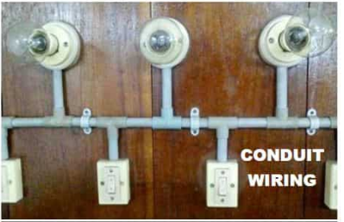
Surface Conduit Wiring

Slide 11
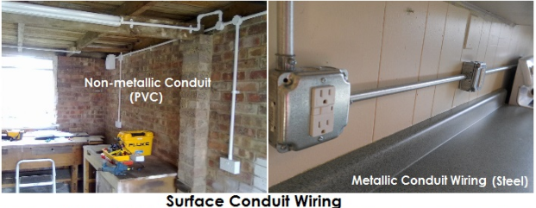

Slide 12
Concealed Conduit wiring
The electrical wiring system inside wall, roof or floor with the help of plastic or metallic piping is called concealed conduit wiring.
It is the most popular, beautiful, stronger and common electrical wiring system nowadays.

Slide 13
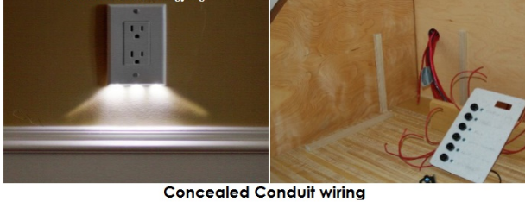

Slide 14
Advantages:
Safe
Appearance is good
No risk of fire and mechanical wear & tear
No risk of electric shock
Long life
Reliable and popular wiring system
can be used even in humidity , chemical effect and smoky areas.

Slide 15
Disadvantages
It is expensive wiring system
Very hard to find the defects in the wiring.
installation is not easy and simple.
Very complicated to manage additional connection in the future.

Slide 16
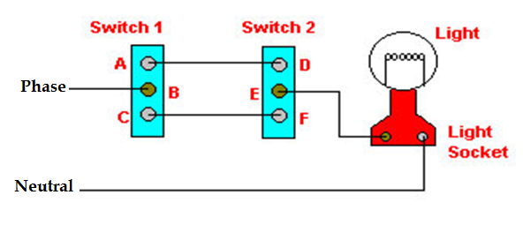
Two-way Control of lamp
Switch S1 | Switch S2 | Light
A | D | ON
A | F | OFF
C | D | OFF
C | F | ON

Slide 17
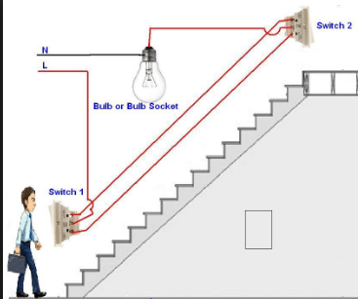
The lamp can be controlled from two different points: one at the top and the other at the bottom - using two- way switches
They are also used in Stair case, bedrooms, big halls and large corridors

Slide 18
Three- way Control of lamp
In case of very long corridors it may be necessary to control the lamp from 3 different points. In such cases, the circuit connection requires two; two-way switches S1and S2 and an intermediate switch S3.
An intermediate switch is a combination of two, two way switches coupled together. It has 4 terminals ABCD. It can be connected in two ways

Slide 19
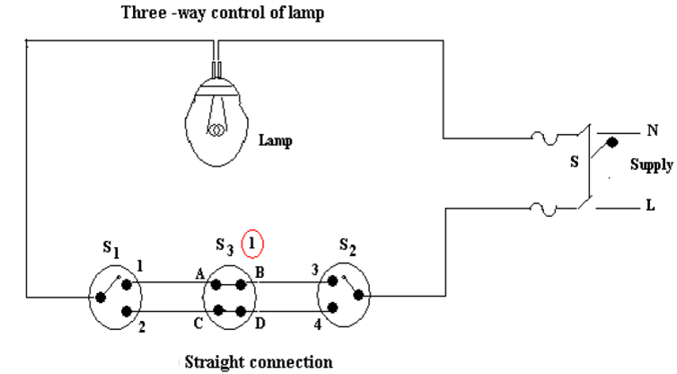

Slide 20
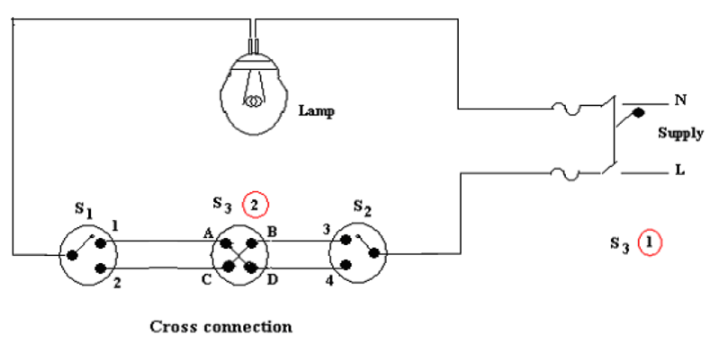

Slide 21
Sl No | Position of Switch S1 | Position of Intermediate Switch S3 | Position of Switch S2 | Lamp ON or OFF
1 | 1 | AB | 3 | ON
2 | 1 | AB | 4 | OFF
3 | 2 | CD | 3 | OFF
4 | 2 | CD | 4 | ON
5 | 1 | AD | 3 | OFF
6 | 1 | AD | 4 | ON
7 | 2 | CB | 3 | ON
8 | 2 | CB | 4 | OFF

Slide 22
Protective Devices
Fuses
Relays
Miniature circuit breakers (MCB)
Earth leakage circuit breakers (ELCB)

Slide 23
Fuse
Fuse is a safety device connected in series with the circuit . Whenever current exceeds the rated value due to overload or short circuit condition, it blows out and protects the apparatus.
Rated Current:
Maximum current that a fuse can carry safely without getting heated and melted
Fusing current: Minimum current at which fuse element melts
Fusing Factor defined ratio of fusing current to rated current

Slide 24
. Equipment safety measures
Fuse
A fuse is a piece of conducting wire having a low melting point. It is rated for a certain current. Whenever the current in a subcircuit exceeds the rated current, the fuse melts and breaks the circuit. Never use a fuse of rating higher than the appliance.
Smaller current rating fuse ( less than 10A) are made of lead-tin alloy.
For higher current ratings (> 10A) it is made of copper, zinc, lead aluminium etc.
Once melts the fuse element must be replaced. The cost of replacement is very less ( around Rs 25)
But the installation of fuse, takes lot of space and always posses a threat of fire hazard.

Slide 25
Working :
carries normal current without heating
When fault occurs, current increases, heat produces and fuse element melts.
Chemical reaction between silver vapour and filling powder results in formation of high arc resistance – arc gets quenched easily

Slide 26
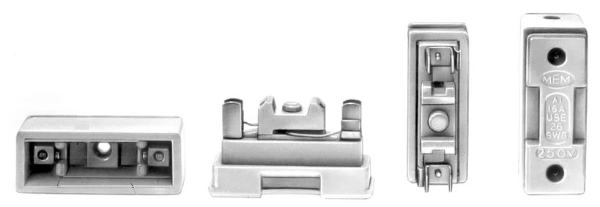
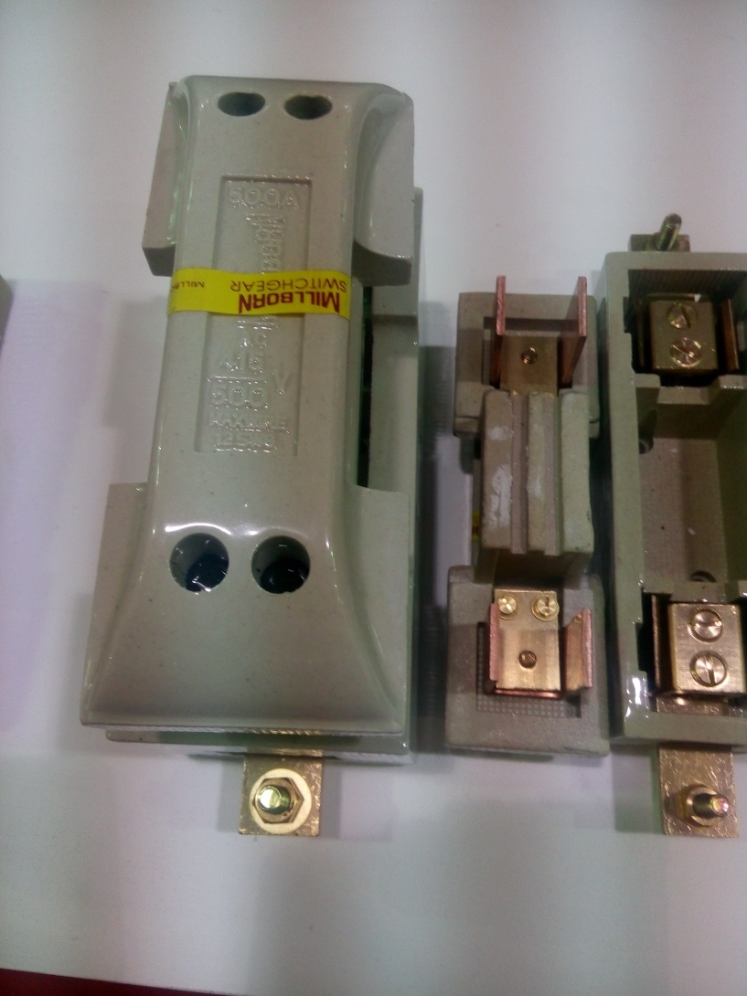
Rewireable fuse ( kit kat fuse)

Slide 27
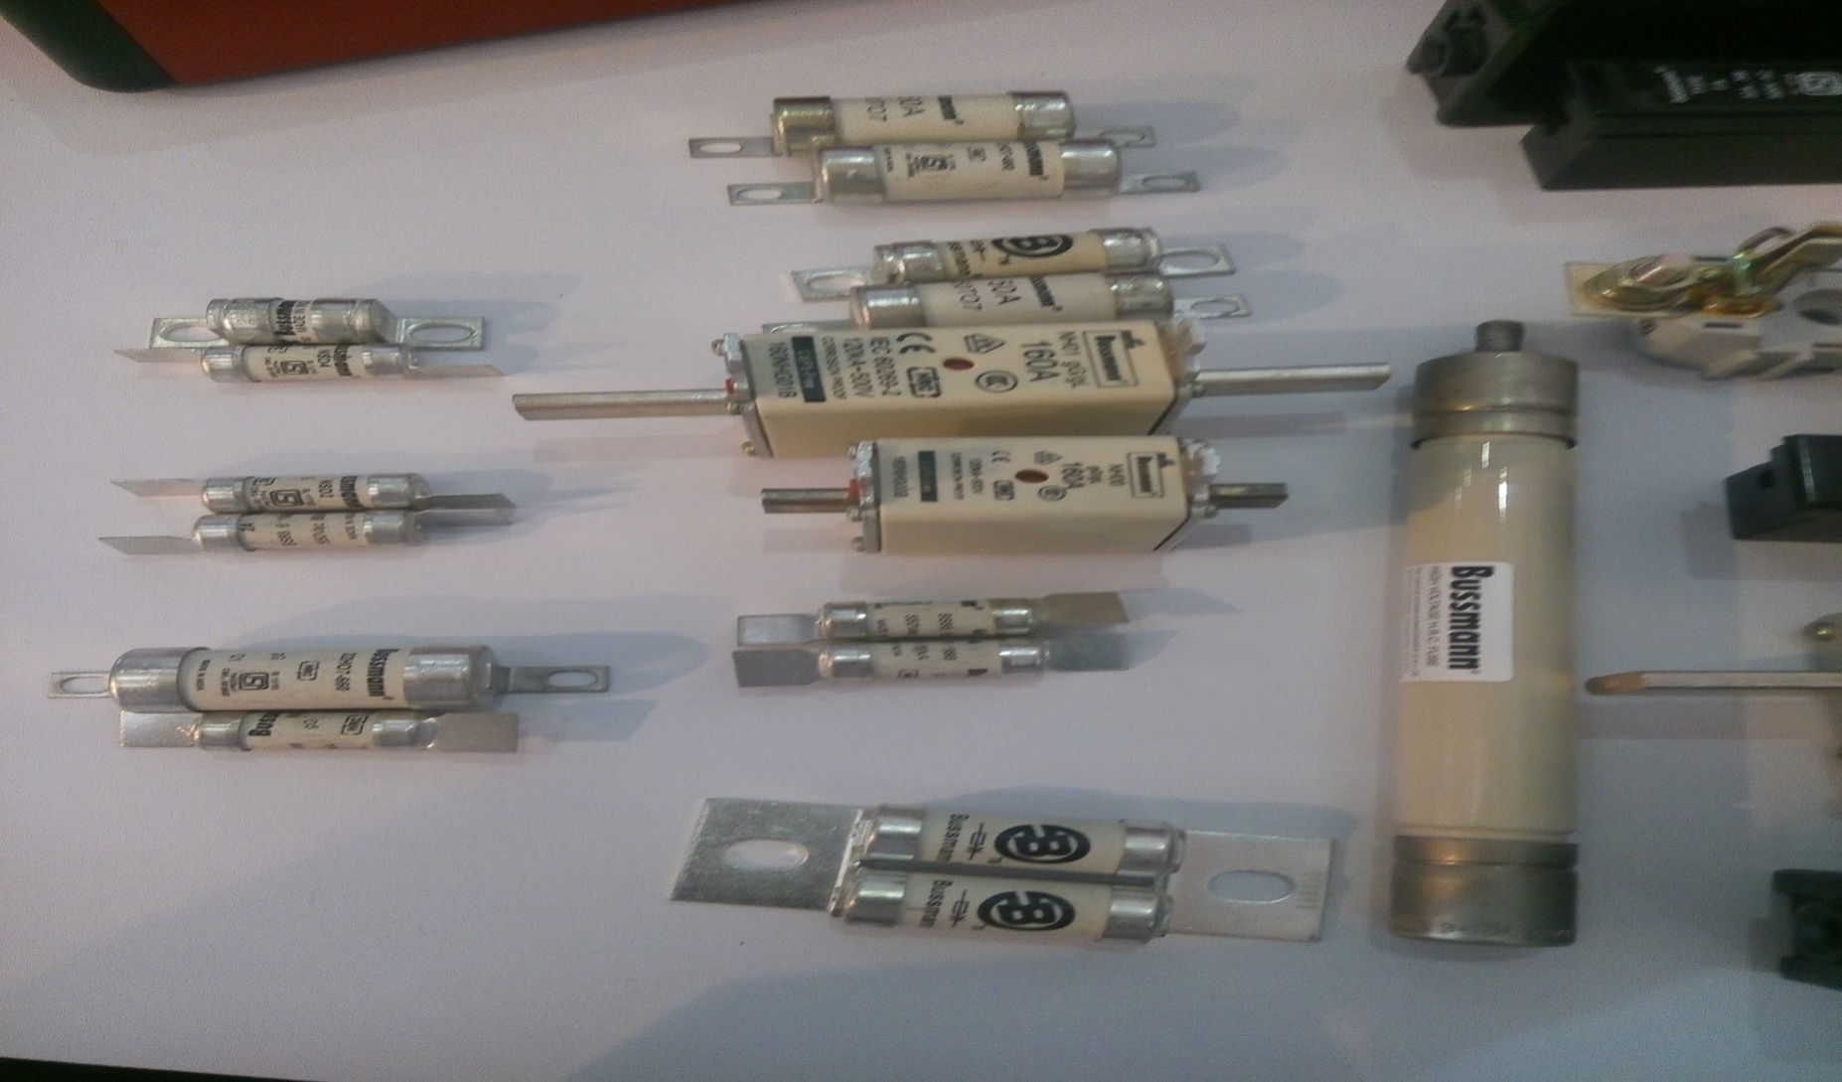
HRC Fuses (High Rupture Capacity)

Slide 28
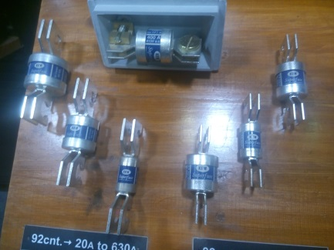


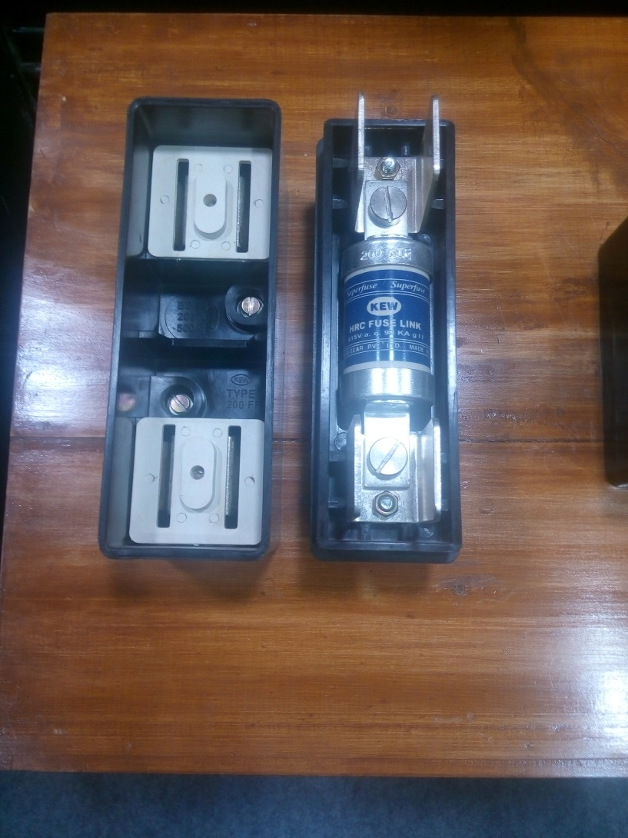

Slide 29
. Equipment safety measures
MCB
MCB ( miniature circuit breaker) is a neat and clean device, which simply trips off itself whenever the current in the circuit exceeds its rating.
After correcting the electrical fault, MCB can be simply reused by switching it ON again.
MCB’s are bit expensive when compared to Fuses ( costing about 150 RS and more)
MCB’s work on the principle of “solenoid”

Slide 30
Miniature Circuit Breaker or MCB
It automatically switches off the electrical circuit during abnormal condition. The fuse does not sense but MCB does it in more reliable way.
MCB is much more sensitive to over current than fuse.
During tripping the switch operating knob comes at its off position, the faulty zone of the electrical circuit can easily be identified. But in case of fuse, fuse wire should be checked by opening fuse grip or cutout from fuse base, for confirming the blow of fuse wire.

Slide 31
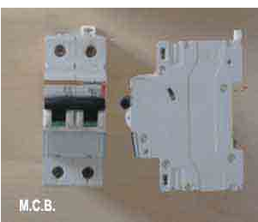
In the case of MCB, quick restoration is possible by just switching on operation but it is not possible in fuse
Handling MCB is more electrically safe than fuse

Slide 32
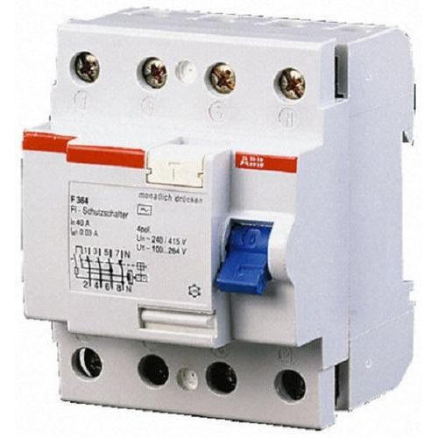
Earth Leakage Circuit Breaker (ELCB)
An Earth Leakage Circuit Breaker (ELCB) is a device used to directly detect currents leaking to earth from an installation and cut the power

Slide 33
Personal safety measures Earthing
The potential of the earth is considered to be at ZERO for all practical purposes as the generator (supply) neutral is always earthed.
The body of any electrical equipment is connected to the earth by means of a wire of negligible resistance to safely discharge electric energy, which may be due to failure of the insulation, line coming in contact with the casing etc.
Earthing brings the potential of the body of the equipment to ZERO i.e. to the earth’s potential, thus protecting the operating personnel against electrical shock.

Slide 34
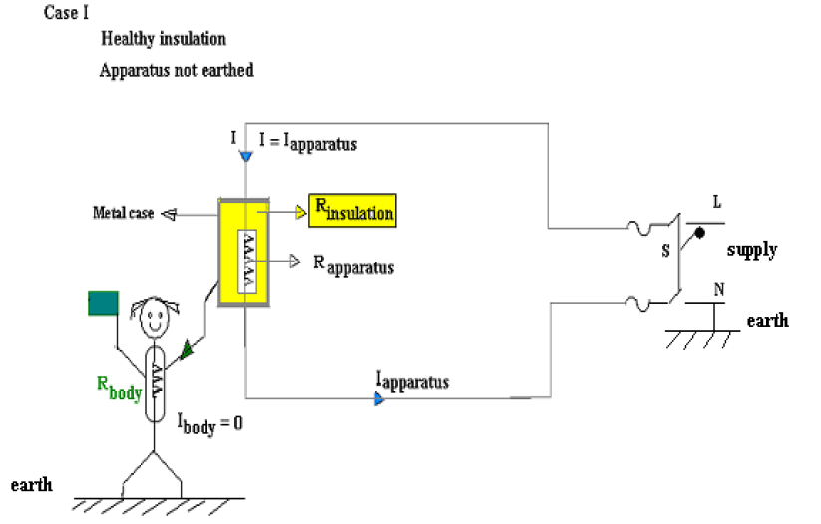
Healthy Insulation R= Infinity, therefore no leakage current flows into body of the equipment.
Current flows through Load resistance only
Person is safe even if he touches body of the apparatus

Slide 35
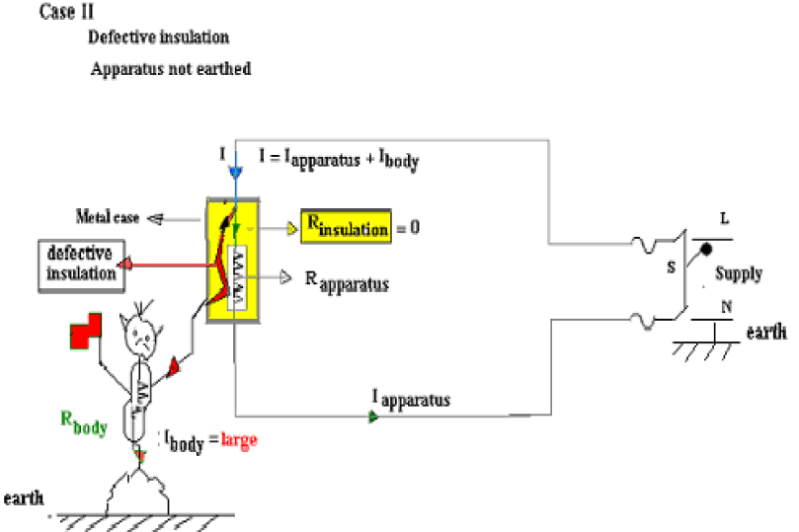
Bad Insulation R= 0, therefore leakage current flows into body of the apparatus and load resistance.
If Person comes in contact of the body of the apparatus, he experiences shock as the apparatus is not earthed

Slide 36
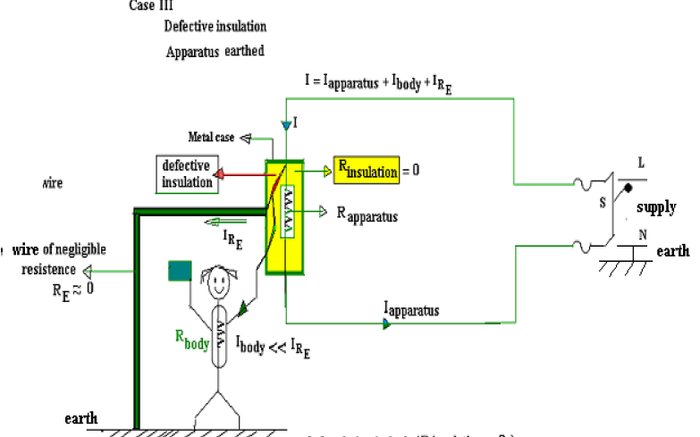

Slide 37
Apparatus is earthed
Insulation is bad ( R=0)
Supply current divides into I _{apparatus}, I _{body}, and I _{earth}
Since earth resistance ( negligible) is very less than body resistance, more current flows through earth
Person in contact with apparatus body does not experience any shock .

Slide 38
Necessity of Earthing
1. To protect the operating personnel from danger of shock in case they come in contact with the charged frame due to defective insulation.
2. To maintain the line voltage constant under unbalanced load condition.
3. Protection of the equipments
4. Protection of large buildings and all machines fed from overhead lines against lightning.

Slide 39
Methods of Earthing:
Plate earthing
Pipe earthing
The typical value of the earth resistance at powerhouse is 0. 5 ohm and that at substation is 1 ohm.
Copper wire or GI wire can be used as earth wire

Slide 40
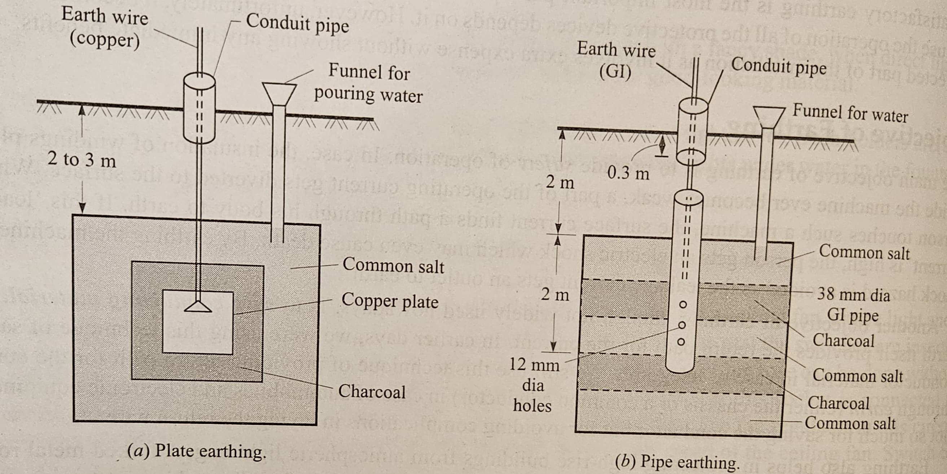
Common salt thickness: 30-mm
Charcoal thickness : 80-mm

Slide 41
In this method a copper plate of 60cm x 60cm x 3.18cm or a GI plate of the size 60cm x 60cm x 6.35cm is used for earthing.
The plate is placed vertically down inside the ground at a depth of 3m and is embedded in alternate layers of charcoal and salt for a thickness of 80mm and 30 mm respectively.
In addition, water is poured for keeping the earth electrode resistance value well below a maximum of 5 ohms.
The earth wire is securely bolted to the earth plate. A cement masonry chamber is built with a cast iron cover for easy regular maintenance.

Slide 42
Common salt thickness: 30-mm
Charcoal thickness : 80-mm

Slide 43
GI (galvanized) iron pipe of 38mm in diameter and length of 2m with 12mm holes on the surface is placed upright at a depth of 4.75m
The area surrounding the GI pipe (15 cms) is filled with a mixture of salt and coal to reduce the earth resistance.
The efficiency of the earthing system is improved by pouring water through the funnel periodically.
The GI earth wires of sufficient cross- sectional area are run through a 12.7mm diameter pipe (at 60cms below) from the 19mm diameter pipe and secured tightly at the top

Slide 44
Electric Shock
A person receives a shock when he comes in contact with the live wire
Severity of the shock depends on the voltage of the wire and the resistance of the person
The maximum current the human body can withstand for a short time ( less than 25 millisecond) is 30mA
If the body is totally wet, the body resistance is 1,000 Ω
If the body is neither wet or dry, the body resistance is about 5 kΩ
If the body is totally dry, then the body resistance is 1 M Ω

Slide 45
Mild shocks produces nervousness
Severe shock can cause unconsciousness and death
Electric current passing through the body can cause cardiac arrest
Damage caused by an electric shock depends on
Voltage level
Route of the current through body
person’s health
Speed with which contact is removed and treatment given

Slide 46
Precautions against electric shock
Do not touch the victim with bare hands when he is still in contact with electricity
Shut off the supply immediately
If supply cannot be switched off, use a non conducting object to push the victim away
When victim is free, check his breathing and pulse and give the treatment

Slide 47
Prevention of Shocks
Ground points must be properly provided to all the sockets to which electrical appliances are connected
Proper earthing must be provided and periodically the earth resistance has to be checked and it does not exceed 3 to 5 Ω
Install ground fault circuit interrupts (GFCIs) in wall outlets located in kitchen, bathroom, basement, garages etc
Cover all electrical sockets with plastic safety caps
Replace all the damaged cords and wirings
Never use an electrical appliances like radio or an iron box near water
Do not touch electrical appliances and switches with wet hands

Slide 48
Electricity Bill
Appliance Power Rating (Watts)*
Air Conditioner (1 Ton)800 – 1000
PC 100 – 450
Laptop30 – 100
Printer15 – 50
Iron Box1000 – 1500
Refrigerator200 – 800
Washing Machine500 – 1500
Water Heater1000 – 3000
Bulb – 100/60/40/18/9/4 W
Ceiling Fan ( normal) -80W, BLDC fans ( upto 32W)
* Approximate values

Slide 49
Electrical tariff
Definition of unit: A unit of energy equal to the energy consumed by a load of one kilowatt over one hour.
For example, if you use a 100-watt light bulb for 10 hours, it will consume 1 kWh of electrical energy (100 watts x 10 hours = 1000 watt-hours = 1 kWh).
1 unit = 1kWh

Slide 50
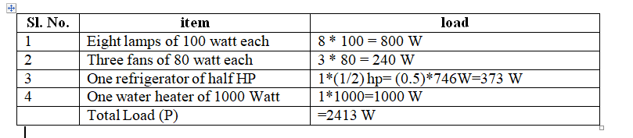
Calculation of electricity bill
The domestic power load in a house comprises the following:
Eight lamps of 100 Watt each, Three fans of 80 Watt each, one refrigerator of half HP,
one water heater of 1000 Watts.
Calculate the total current taken from the supply of 230 volts
Calculate the energy consumed in a day if on an average only a quarter of the
above load persists all the time.
c. What would be the monthly electricity cost If the per unit cost is rupees 7.5/-?
Solution:

Slide 51
a. Current taken from the supply, I = P/V = 2413/230 =10.5 A
b. Energy consumed for a day = 2413 W * (1/4) * 24 = 14,478 Wh = 14.478 kWh
c. Cost of electricity per month, if the per unit cost is rupees 7.5/-
Cost of electricity = Units consumed in a month * Per unit cost
Cost of electricity = 14.478 * 30 days * 7.5 = Rupess 3,257.55 approx

